Slide 1
Biology Week 2018
Quiz Questions
Ages 16-18

Slide 2
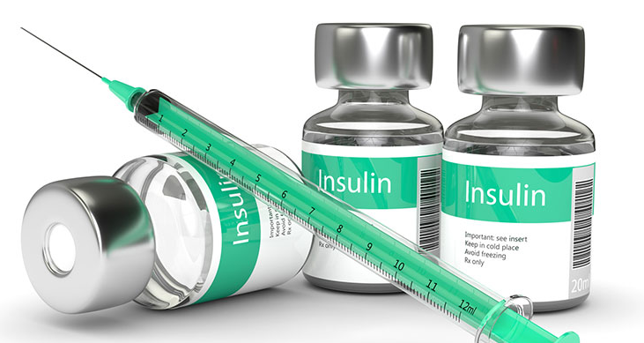
Question 1.
Insulin activates enzymes involved in the conversion of ______ to ______
(1 mark)
Notes:
Answer:
Glucose, glycogen

Slide 3
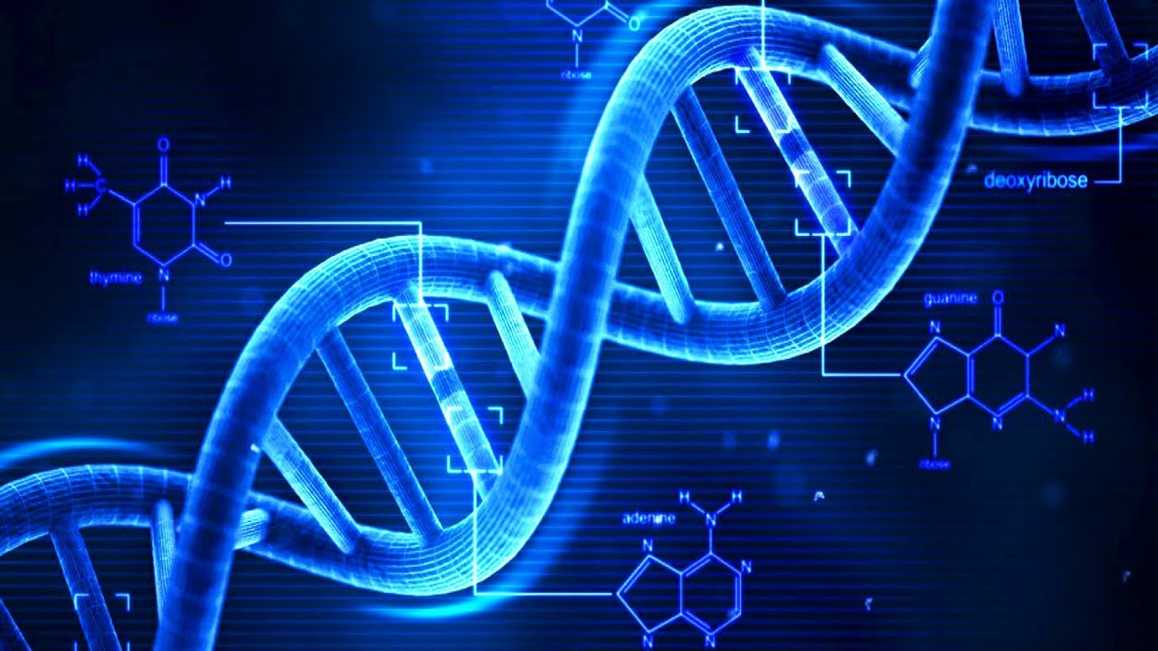
Question 2.
Which base pairs with guanine in DNA?
(1 mark)
Notes:
Answer:
Cytosine

Slide 4
Question 3.
Can you match these three famous scientists to their areas of expertise?
(3 marks)
Watson and Crick
Edward Jenner
Jane Goodall
Creation of vaccines
Structure of DNA
Primatology
Notes:
Answer:
Watson and Crick – structure of DNA
Edward Jenner – creation of vaccines (smallpox)
Jane Goodall – primatology

Slide 5
Question 4.
Name the structures of this plant cell
(4 marks)
Notes:
Answer:
Left side, from top to bottom – Cytoplasm, vacuole
Righrt side, from top to bottom – cell wall, chloroplast

Slide 6
Question 5.
If you work as an endocrinologist, what do you specialise in?
(1 mark)
Notes:
Answer:
The hormonal systems

Slide 7
Question 6.
What percentage of each gas is our atmosphere made up of?
Nitrogen
Oxygen
Argon
(3 marks)
78%
1%
21%
Notes:
Answer:
Nitrogen – 78%
Oxygen – 21%
Argon – 1%

Slide 8
Question 7.
Draw a molecule of ATP
(3 marks)
Notes:
Answer:
Looking for a molecule that has adenine attached to a ribose molecule, which is then attached to three phosphates connected in a line

Slide 9
Question 8.
What percentage of human DNA is identical in every individual?
0.1%
45%
99.9%
(1 mark)
Notes:
Answer:
99.9%

Slide 10
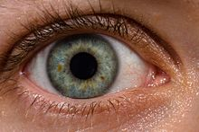
Question 9.
Which cells in human eyes are responsible for detecting colour?
(1 mark)
Notes:
Answer:
Cones

Slide 11
Question 10.
Approximately how many more bacterial cells are there in your body than your own cells?
1.5 times more
5 times more
10 times more
100 times more
(1 mark)
Notes:
Answer:
10 times more

Slide 12
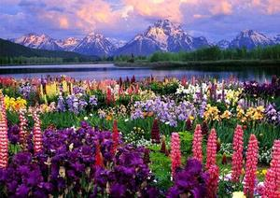
Question 11.
Which of these native UK flowers is poisonous to animals?
Buttercup
Bluebell
Snowdrop
(1 mark)
Notes:
Answer:
Buttercup

Slide 13
Question 12.
What is the common name for the species Panthera leo?
(1 mark)
Notes:
Answer:
Lion

Slide 14
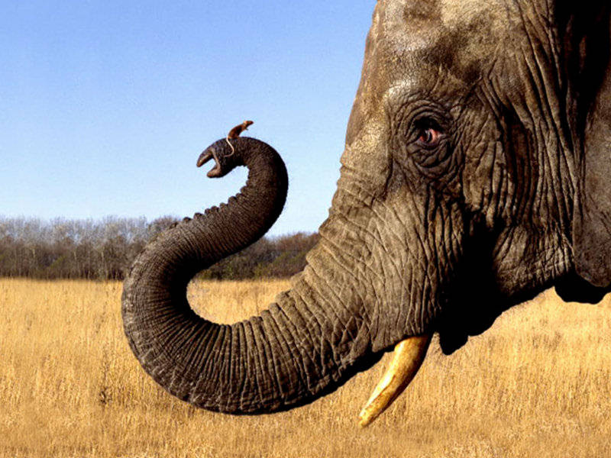
Question 13.
Elephants have a ______ surface area to volume ratio than mice
(1 mark)
Notes:
Answer:
Lower

Slide 15
Question 14.
A mutation that causes a different a base substitution but results in no change to the amino acid is known as what?
(1 mark)
Notes:
Answer:
A silent mutation

Slide 16
Question 15.
What is the smallest measurement a light microscope can see?
(1 mark)
Notes:
Answer:
0.2µm (micrometres), 2x10⁻⁷

Slide 17
Question 16.
Fill in the gaps:
Kingdom, phylum, _____, order, _____, _____, species
(3 marks)
Notes:
Answer:
Class, family, genus

Slide 18
Question 17.
What does an ichthyologist study?
(1 mark)
Notes:
Answer:
Fish

Slide 19
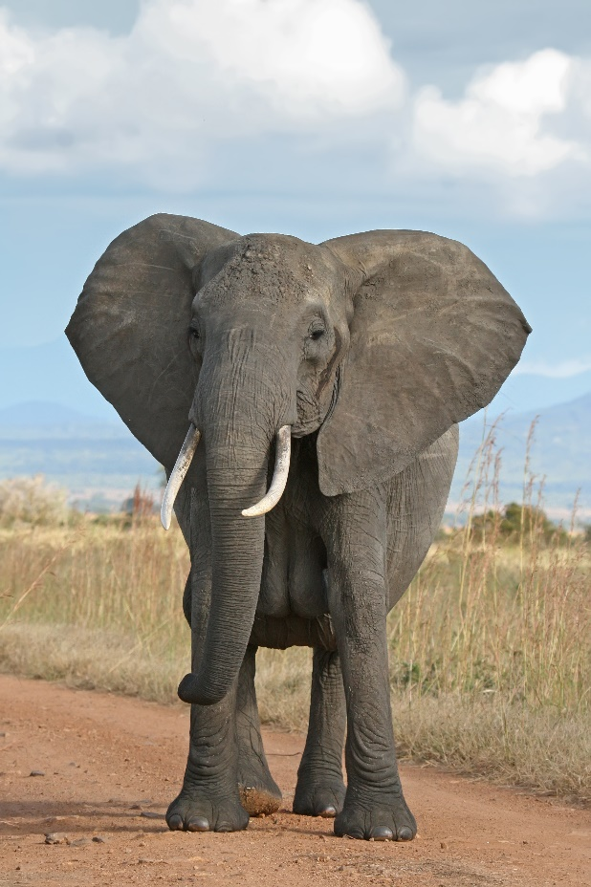
Question 18.
True or false?
Elephants are herbivores
(1 mark)
Notes:
Answer:
True

Slide 20
Question 19.
Which species has the highest number of genes?
a) Chimpanzees
b) Humans
c) Mice
d) Rice
(1 mark)
Notes:
Answer:
Rice (50,900)
Chimpanzees have 20,800
Humans have 23,600
Mice have 23,100

Slide 21
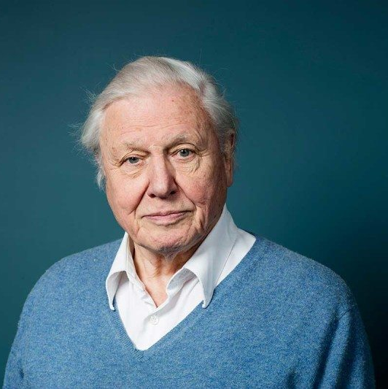
Question 20.
What did Sir David Attenborough study at university?
(1 mark)
Notes:
Answer:
Natural sciences (geology and zoology)

Slide 22
31
How did you do?
Follow us on Twitter @RoyalSocBio using the hashtag #BiologyWeek to let us know!
Download more Biology Week resources:
https://www.rsb.org.uk/get-involved/biologyweek

