Slide 1
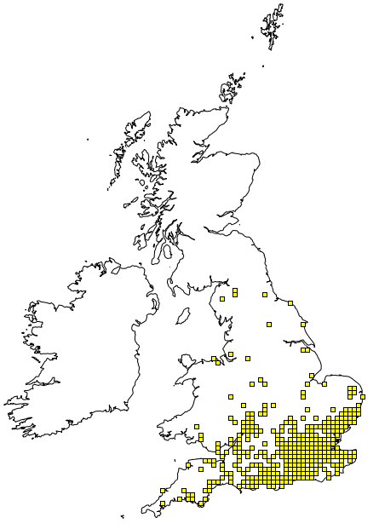
Stag Beetle
The Big Daddy
UK's largest beetle, and one of the most distinct.
Regarded with both admiration and fear, it is the only UK insect to have featured on a postage stamp twice!
Is it your favourite though?
Lucanus cervus

Slide 2
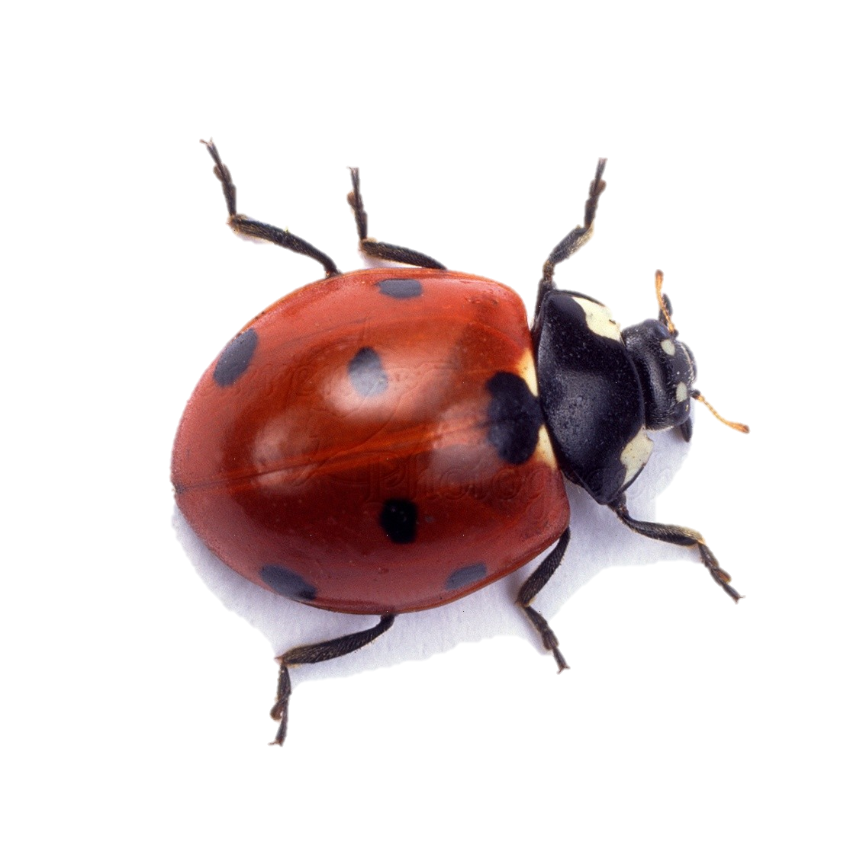
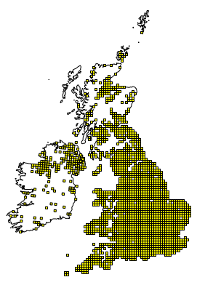
Seven-Spot Ladybird
The Divine Messenger
Ladybirds enjoy one of the shiniest of reputations of any UK insect.
The seven-spot lady bird is very widespread, found throughout the UK. It is a ubiquitous inhabitant of gardens and parks and will turn up anywhere there are aphids for it to feed on. In the Middle ages it was considered a messenger from the heavens……
Is it your favourite
though?
Coccinella 7-punctata
Data from the NBN Gateway

Slide 3
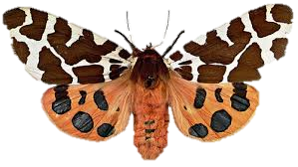
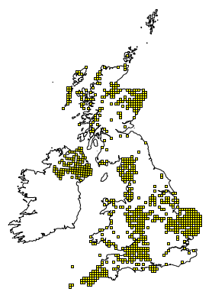
Garden Tiger Moth
The Woolly Bear
The Garden Tiger Moth is a striking beauty, and one of the best known moths in the UK.
Is it your favourite though?
Tiger moth’s names are a slight misnomer; most tiger moths are spotted not stripped. They should strictly be called leopard moths!
The hairy, fast moving caterpillar is also well known and recognisable, most commonly referred to as ‘woolly bears’.
Data from the NBN Gateway

Slide 4
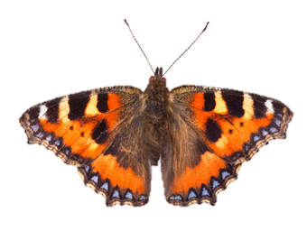
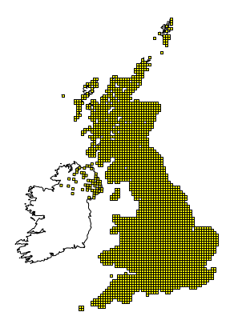
Small Tortoiseshell
The House Sitter
One of our most familiar butterflies, visiting gardens to feast on buddleia and ice-plants.
The Small Tortoiseshell is one of the emblems of sunny days in the gardens, and its colourful form encapsulates all our pleasant associations with butterflies. It is also the butterfly most likely to hibernate inside the house, Would it be welcome in your home?
Is it your favourite UK Insect?
Aglais urticae
Data from the NBN Gateway

Slide 5
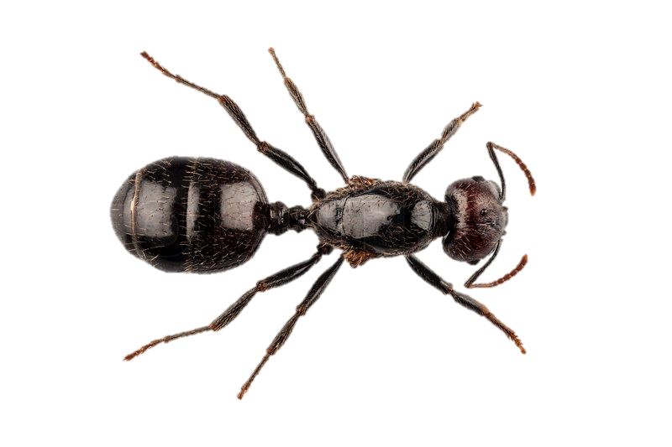
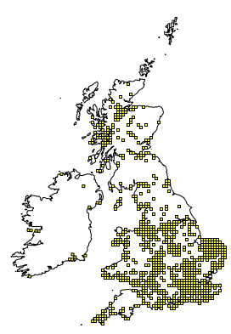
Black Garden Ant
The Socialite
The Black Garden Ant is the common small ant found in gardens.
Ants are not big on individuality; instead, most live for the colony, a tightly knit organisation, formed by altruistic cooperation, with interior networks, caste systems and even a kind of chemical language.
Are you an admirer of
the colony?
Is the Ant your
favourite?
Lasius niger
Data from the NBN Gateway

Slide 6
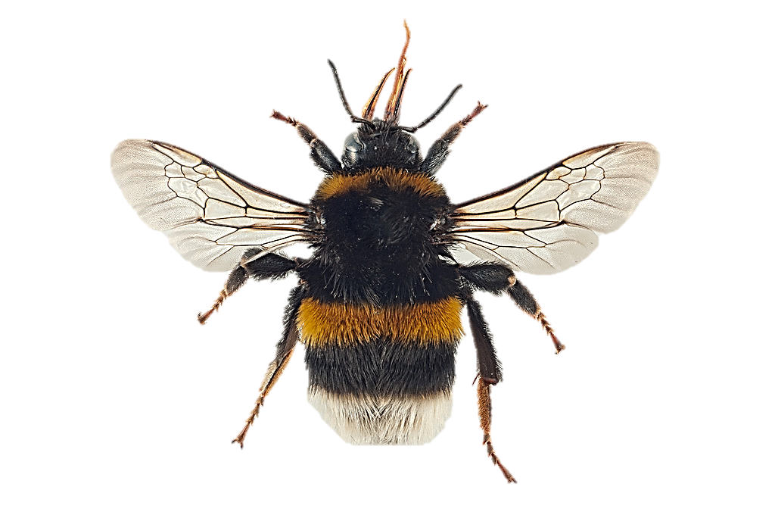
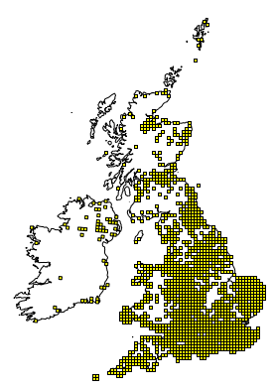
Buff-tailed Bumblebee
The Bees Knees
Bumblebees have large furry bottoms, but their name refers to their hum, not their bum.
The Buff-tailed Bumblebee is named after the queen’s buff-coloured ‘tail’. It is the earliest Bumblebee you are likely to see in your garden, with the fat queen Buff-tailed Bumblebee emerging first, to replenish her food reserves.. Have you spotted the Buff-tailed bumblebee in your garden.
Is it your favourite?
Bombus terrestris
Data from the NBN Gateway

Slide 7
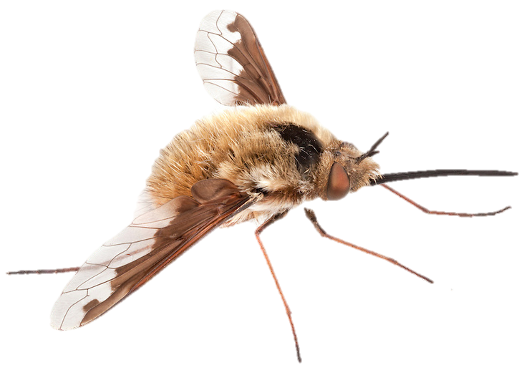
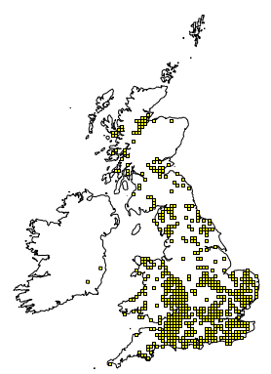
Large Bee-fly
The Impersonator
There are more than a dozen species of bee-fly in the UK, but the Large Bee fly is one of the most common.
It is a bee mimic; a tiny, furry ball of an insect, with a long stiff tongue out in front like a drawn out sword, with long hairy legs. Don’t be fooled by its friendly image however, as it is also a parasite of solitary bees, wasps and beetles. ‘Cute’ or ‘nasty’, but…..
Is it your
favourite
UK
Insect?
Bombylius major
Data from the NBN Gateway

Slide 8
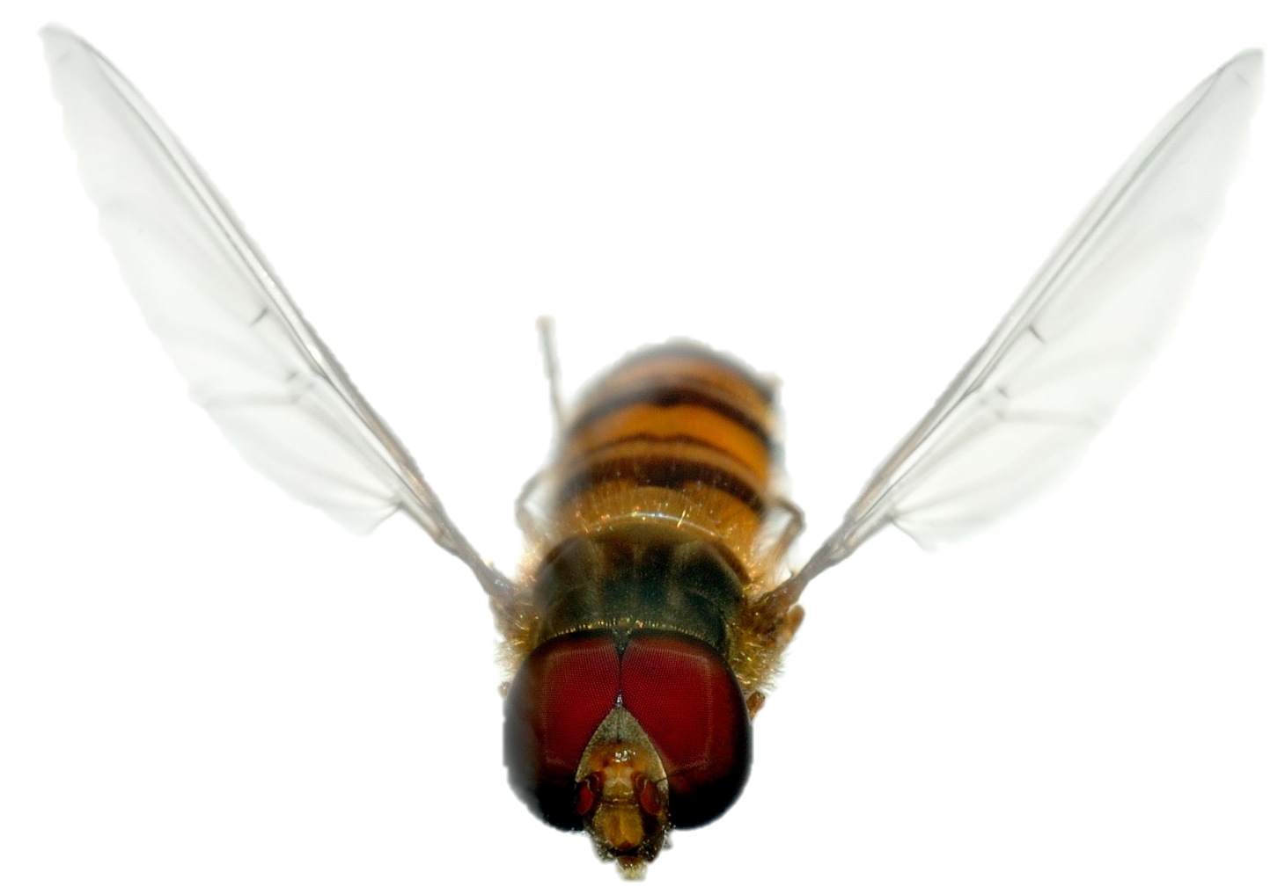
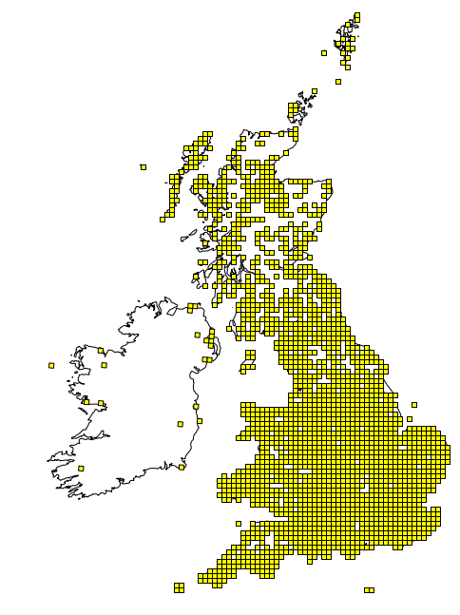
Marmalade Hoverfly
The Gardner’s Friend
Hoverflies are among the friendliest and least disconcerting of flies, hovering effortlessly at flowers.
Hoverflies are the most popular groups of flies. Many gardeners go out of their way to attract them, and to some they are considered the ‘Butterflies of the flies’. They are very important pollinators, as well as pest controllers. Gardner’s love them, but….
Is it your favourite?
Episyrphus balteatus
Data from the NBN Gateway

Slide 9
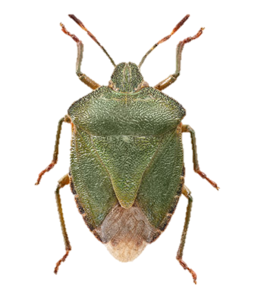
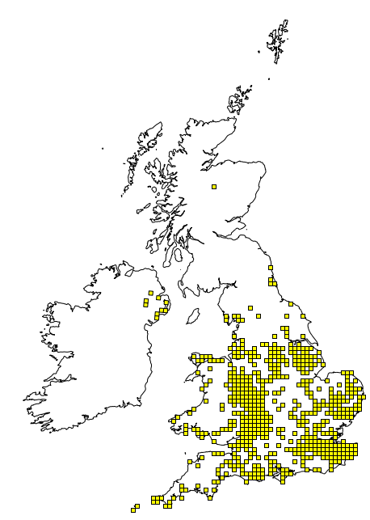
Green Shieldbug
Kicking up a stink
Shield bugs are ‘true bugs’ belonging to the order Hemiptera.
Being less skittish than many insects, Shieldbugs often allow us to get a good look at their squat, geometrically shaped bodies, whether it be basking on a leaf, or running along the ground. Have you seen one where you live?
Is it your favourite?
Palomena prasina
Data from the NBN Gateway

Slide 10
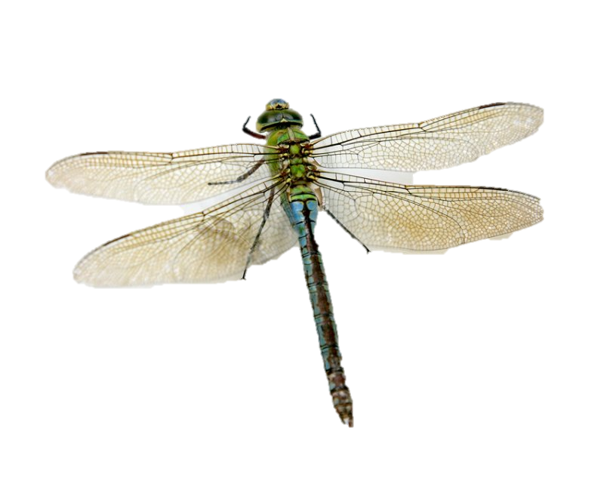
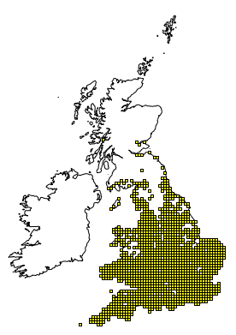
Emperor Dragonfly
Lord of the Skies
The Emperor Dragonfly is a very large, impressive dragonfly - the biggest in the UK.
Perhaps the most dazzling of insects: a colourful acrobat with large wings on a broomstick body. The dragonfly will fiercely defend its territory, tirelessly patrolling the margins of ponds and lakes. the Emperor Dragonfly is perhaps the most impressive of all, but….
Is it your favourite
insect?
Anax imperator
Data from the NBN Gateway

Slide 11
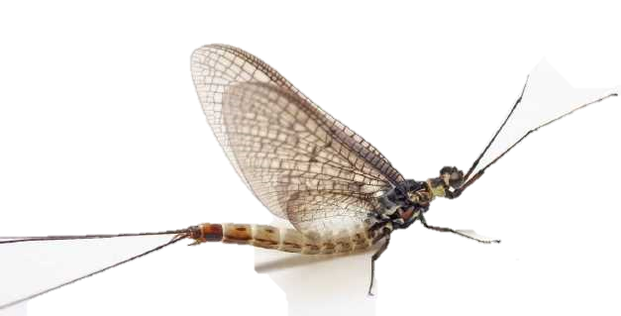
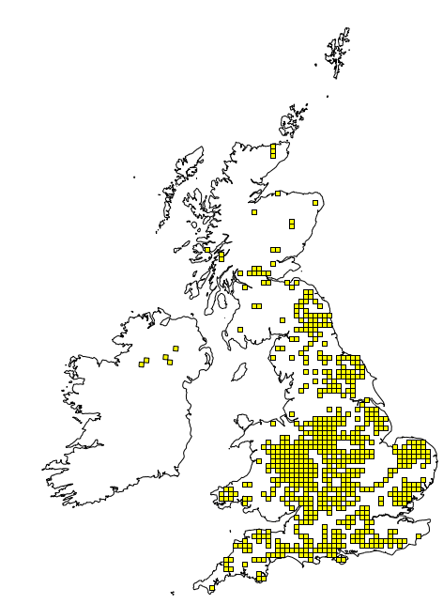
Green Drake Mayfly
Fisherman’s Friend
One of our most familiar butterflies, visiting gardens to feast on buddleia and ice-plants.
The Small Tortoiseshell is one of the emblems of sunny days in the gardens, and its colourful form encapsulates all our pleasant associations with butterflies. It is also the butterfly most likely to hibernate inside the house, Would it be welcome in your home?
Is it your favourite UK Insect?
Ephemera danica
Data from the NBN Gateway

Slide 12
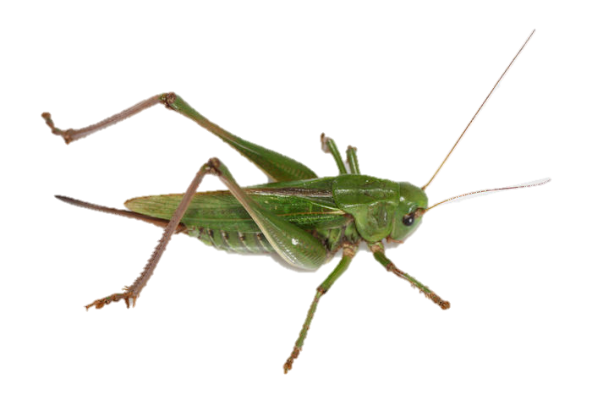
Green Drake Mayfly
Fisherman’s Friend
One of our most familiar butterflies, visiting gardens to feast on buddleia and ice-plants.
The Small Tortoiseshell is one of the emblems of sunny days in the gardens, and its colourful form encapsulates all our pleasant associations with butterflies. It is also the butterfly most likely to hibernate inside the house, Would it be welcome in your home?
Is it your favourite UK Insect?
Ephemera danica
Data from the NBN Gateway

