Slide 1
Pfizer Early Careers Opportunities
Michelle Latter
Quality and Compliance Lead
Drug Product Manufacturing
Pharmaceutical Sciences
Nov 2022
Breakthroughs that change patients’ lives ®

Slide 2
Our Purpose
Breakthroughs that
change patients’ lives®

Slide 3
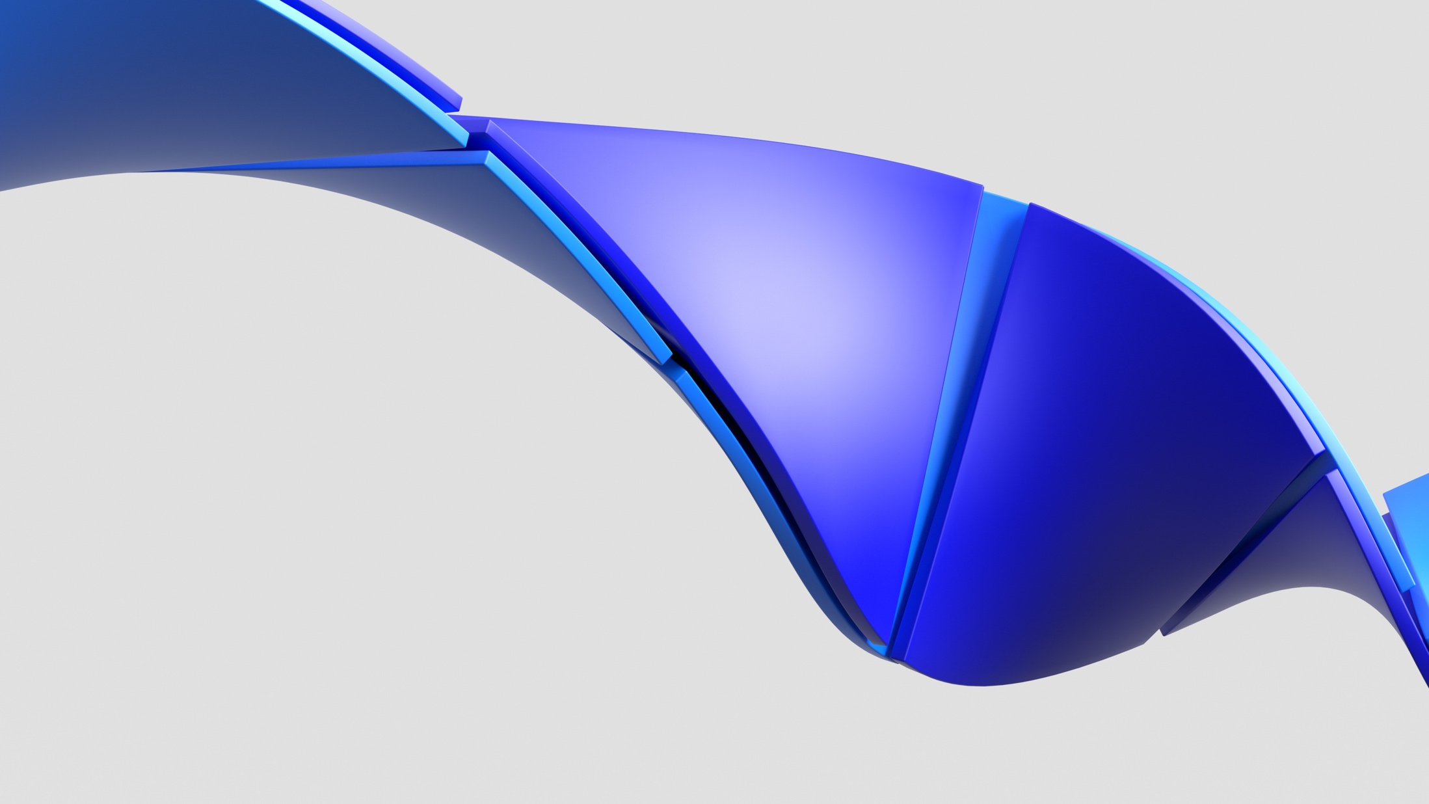
At Pfizer, we apply science and our global resources to bring therapies to people that extend and significantly improve their lives.
We strive to set the standard for quality, safety, and value in the discovery, development, and manufacture of health care products.
Our global portfolio includes medicines and vaccines as well as many of the world's best-known consumer health care products.

Slide 4
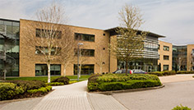
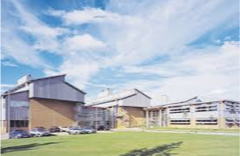
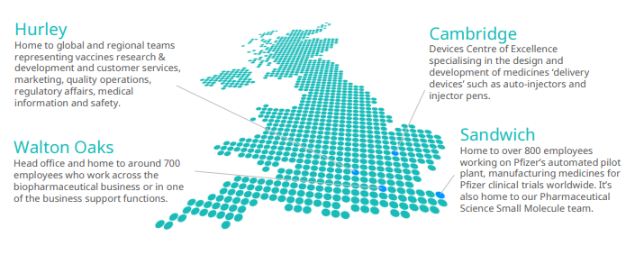
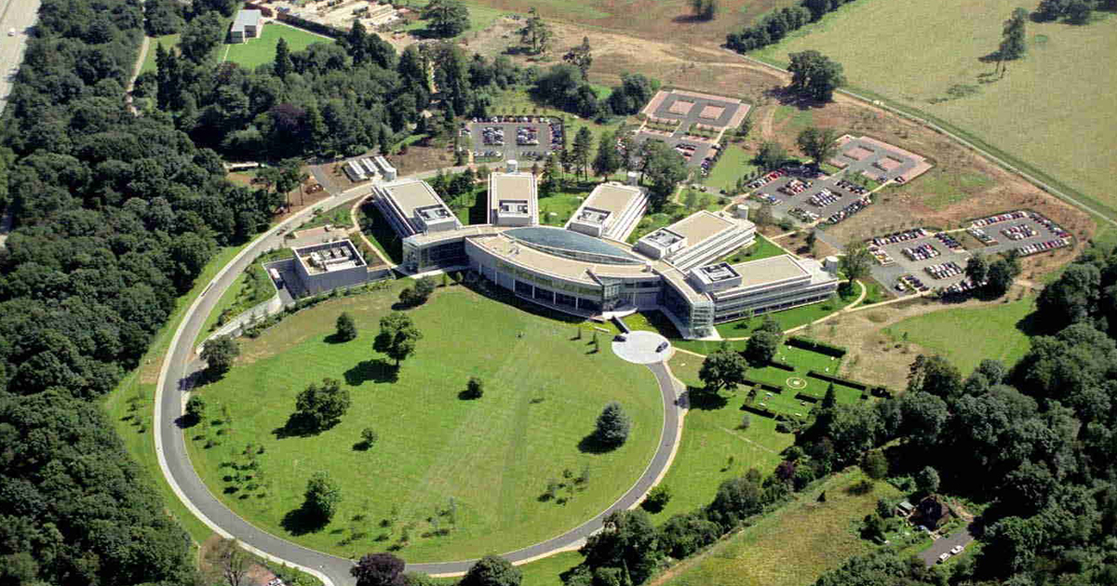
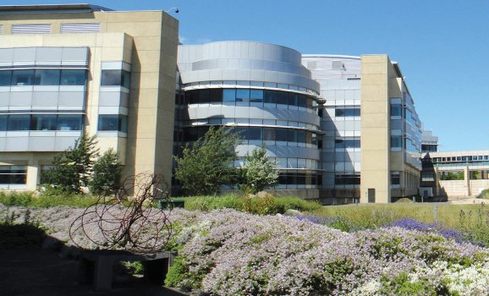
In the UK, we have around 2,400 colleagues across four locations, working within our commercial business, research and development (R&D), manufacturing, packaging and distribution operations
Locations
Cambridge
Device Centre of Excellence
Hurley, Berkshire,
Vaccines Site
Walton Oaks, Surrey
Pfizer UK Commercial HQ
Sandwich, Kent
Research and Development Site

Slide 5
Early Careers at Pfizer UK
Apprenticeships – various levels and course lengths to ‘earn while you learn.’ 50+ current Apprentices with 20+ roles for 2022
Undergraduate Programme – 12 month placement (Sept - Aug) – 109 positions for 2022. Application process opens in August in the year prior to placement commencing.
Graduate Programme – 2 year contract rotational programme
Summer Student Programme. Positions for University Students seeking work experience. Placements can be anything from 2 week-12 weeks.
Direct Entry – Pfizer Full-time Employees (FTEs) or contractors
Early Careers, Pfizer UK

Slide 6

Our Undergraduate Programme
Our programme gives undergraduates the opportunity to experience working in Pfizer’s Research & Development and Commercial business over 12 months. We will provide you with a unique set of experiences that will serve to develop and broaden the critical skill sets and competencies that you will need to be successful in the business environment.
You will be involved in important departmental activities and projects, given a high-level of responsibility and the opportunity to really contribute to the success of the team in which you work.
Placements are based across four of our UK sites: Kent, Surrey, Cambridge and Maidenhead.
Early Careers Pfizer UK

Slide 7
Our Graduate Rotation Programme
In the Commercial business:
  5 Graduates the opportunity to complete a 2-year rotation
  3 areas – Marketing, Sales and 1 other business area
  We partner with an external company developing critical skill sets and competencies as well as providing the opportunity to explore careers within the business.
  To apply, you must be participating in our Undergraduate programme.
In the Research and Development business:
  3 Graduates the opportunity to complete a 2-year rotation
  3 areas – Material Sciences/Biopharmaceutics, Formulation/Process Development and Drug Product Supply
  Recruit from external candidates and current Undergrads, recruitment launched Q3 annually
Early Careers Pfizer UK

Slide 8
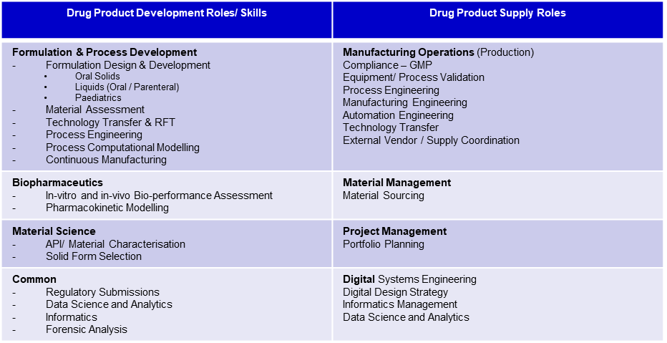
Other Direct Entry Position Opportunities
At present, all other opportunities can be found at our Pfizer careers page, searching under UK locations.
Recommend familiarization with our job titling and job role descriptions.
Pay particular attention to Person Specifications and roles suitable for candidates with science qualifications
Early Careers Pfizer UK

Slide 9




Salary and Benefits
Salary and Pension
Training & Volunteering
Support & Opportunities
Competitive Salary – benchmarked externally
25.5 days paid annual leave
Defined contribution pension
Bonus eligible (excluding Undergrads and Apprentices)
Pfizer Learning Academy
Self-directed learning e.g. leadership
Technical training
5 Volunteering days
Onsite facilities
Access to professional networking
Opportunity to become a STEM ambassador
Opportunity to join CRGs (Colleague Resource Groups e.g. DE&I)
Mentoring and Coaching Schemes
Early Careers Pfizer UK

Slide 10
Example Career options in Pharmaceutical Sciences at Pfizer Sandwich
Oral Products
Development
Informatics
Material Sciences
People
Leadership
Process
Chemistry
Analytical
Sciences
Parenteral
Development
Drug Delivery
Quality
Regulatory
Supply Chain
(manufacturing)
Project Management
Intellectual
Property
Process Engineering
Business
Development
Modelling
+
Commercial
Organisation

Slide 11


Further information/guidance
https://www.pfizer.co.uk/careers
Sue Hergest – Early Careers Recruitment Manager – Suzanne.Hergest@pfizer.com
Research! It’s a 2 way process…
Company Values
Company Culture
In the news…….
LinkedIn
Undergraduate Placement Year invaluable in furthering career experience and opportunities

Slide 12

A career in the Pharma industry
- Myths and Legends
X First Class Degree and ONLY the Best Grades
X I don’t have everything in the job advert so there’s no point applying
X Industry is mostly about Chemistry
X You NEED a PhD to get a job in Industry
X You spend all your time in a lab
X It is difficult to change your career path once you are in Industry

Slide 13

Applying for a position at Pfizer
What makes YOU unique?
Tailor both your CV and Cover Letter to the role advertised
Take note if the job advert only asks to complete a specific Application form
    Career Aim vs Personal Statement
        Career Aim: Example…
        An entry-level position in public relations which will utilise the organisational and communication skills developed through my involvement with ABC Co. and promotional work during vacations.
    Vs Personal Statement: Example…
    A motivated, adaptable and responsible graduate with good communication skills who enjoys a challenge and is keen to begin a career in public relations
    Know your own strengths and gaps – what skills do you want to develop
    Describe how you have the attributes, competencies, skills and knowledge about the role with examples of your own experience
    ‘Tell me about a time when…’
Early Careers, Pfizer UK

Slide 14





Company Values and job applications
Company values support the vision, culture and identity of a company.
They’re important because they;
Shape every important organisational decision.
Educate clients, employees and customers about what the company stands for.
Help applicants identify whether the company fits with their own values.
They are especially important for you because…
Showing an understanding - and demonstrating how you identify - with company values in your application will hugely improve your chances of success.
14

Slide 15

Competencies that Pfizer looks for during the application and interview process
Acts Decisively
Seizes Accountability
Change Agile
Self Awareness
Peer Relationships
Digital Capability
Commits to “Breakthroughs” (Culture, Values and Mission of Pfizer)
Functional/Technical Skills

Slide 16

What advice would I have given myself at School or University
Passion
Research
Work Experience
Invest in You
Your scientific development
Your personal development (people, networks, relationships)
Be Open Minded
Role and job types, locations
Consider different countries
Joy!
Follow what interests you, what makes you curious to know more
Its never too early to research your career – talk to people, internet searches on different jobs, companies, locations
Try to get diverse work experiences – technical and soft skills (e.g. working in a team, on a project, time management)
Breadth of knowledge, skills and competencies
Look for other career options (Plan B!)
Love what you do! Your career is a journey, change is ok!

Slide 17








Learn More About Pfizer
Facebook
www.facebook.com/pfizer
www.pfizer.com
PfizerWorld
http://world.pfizer.com
(for colleagues)
Twitter
twitter.com/pfizer_news
Breakthroughs
www.breakthroughs.com
LinkedIn
linkedin.com/company/pfizer
Instagram
www.instagram.com/pfizerinc
YouTube
www.youtube.com/pfizer

Slide 18

Questions?

Slide 19
Thank You
Breakthroughs that change patients’ lives ®

