Slide 1
HOW TO USE THIS PRESENTATION
This Presentation should be used alongside the Biology Careers Lesson Plan.
Clickable URL links appear as www.domain.com
References to specific careers resources appear in green boxes.
Activities appear in blue boxes.
You can find out more about the Royal Society of Biology at www.rsb.org.uk.
Notes:
About this resource

Slide 2
Overview
Mind map
Careers: resources and activities
Further support for students
Biology Changing the World
Notes:
Overview of resource

Slide 3
Additional teaching resources
Practical Biology
Tried and tested practical activities that explain biological concepts:
www.nuffieldfoundation.org/practical-biology/topics
SciberMonkey
Database of learning resources that have been quality assured by science teachers:
www.scibermonkey.org
Notes:
About the resources:
Practical Biology
Tried and tested practical activities that explain biological concepts.
Includes CLEAPSS safety advice, student sheets, technician guidance notes and equipment lists.
Resource developed by the Nuffield Foundation and the Royal Society of Biology in association with CLEAPSS.
SciberMonkey
Database of dynamic learning resources for science subjects.
Content quality assured by science teachers.
Resource originally created by the Biochemical Society, an currently run by the Royal Society of Biology.

Slide 4
We would like to thank the Biochemical Society for their generous support for this project, which has allowed us to produce this Initial Teacher Education resource.
This is part of a collection of new careers resources which help teachers highlight to their students future careers and the opportunities of studying bioscience subjects beyond school.
Notes:
Biology Careers Lesson

Slide 5
Biology Careers www.rsb.org.uk/careers
Notes:
Biology Careers Lesson

Slide 6
Learning outcomes
By the end of this lesson, you will:
Have explored a variety of biology careers
Have understood how to access careers information provided by the Royal Society of Biology
Notes:
Learning outcomes

Slide 7
Mind map
What is a biologist?
What biology careers can you think of?
What might you study?
What skills might you develop?
Notes:
Activity 1: Mind map

Slide 8
Biologists study organisms and the relationship they have with their environment.
Job titles you might see for biologists:
Accountant
Bioengineer
Bioinformatician
Clinical technician
Curator
Doctor
Epidemiologist
Geneticist
Librarian
Mycologist
Neuroscientist
Patent lawyer
Press officer
Publisher
Teacher
Zoologist
Notes:
Activity 1: Mind map
Example answers (“What biology careers can you think of?”).
Adapted from:
www.rsb.org.uk/images/Next_Steps_Booklet_v2.pdf
www.rsb.org.uk/images/Spotlight_on_the_Life_Sciences_-_A_Guide_to_Biology_Careers.pdf
www.rsb.org.uk/careers-and-cpd/careers/make-a-difference

Slide 9
What biologists might have studied:
Biochemistry
Biotechnology
Cell biology
Ecology
Endocrinology
Environmental science
Genetics
Immunology
Marine biology
Microbiology
Molecular biology
Neurobiology
Nutritional science
Pathology
Pharmacology
Physiology
Plant science
Zoology
Notes:
Activity 1: Mind map
Example answers (“What might you study?”).
Adapted from:
www.rsb.org.uk/careers-and-cpd/careers/make-a-difference

Slide 10
What skills biologists might have developed:
Analytical skills
Attention to detail
Communication
Creative thinking
IT skills
Leadership
Multitasking
Numeracy and maths
Observational skills
Planning
Presentation skills
Problem-solving
Research
Resource management
Scientific techniques
Self-motivation
Team working
Time management
Notes:
Activity 1: Mind map
Example answers (“What skills might you develop?”).
Adapted from:
www.rsb.org.uk/images/Next_Steps_Booklet_v2.pdf
www.rsb.org.uk/careers-and-cpd/careers/make-a-difference

Slide 11
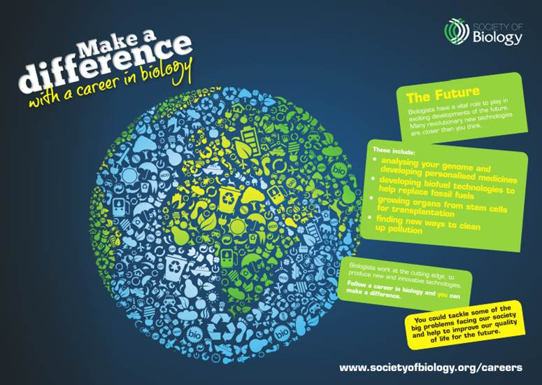
Careers resource
Make a Difference posters and website highlight career paths biologists can take:
www.rsb.org.uk/careers-and-cpd/careers/make-a-difference
Notes:
Careers resource
About the resource:
Make a Difference
Highlights career paths biologists might take, including workplaces, job titles and courses.
Resource was jointly developed by the Biochemical Society, British Ecological Society, British Pharmacological Society, Microbiology Society, Society for Experimental Biology, Royal Society of Biology and The Physiological Society.

Slide 12
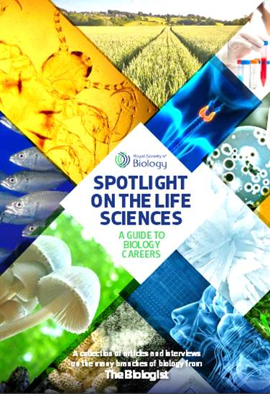
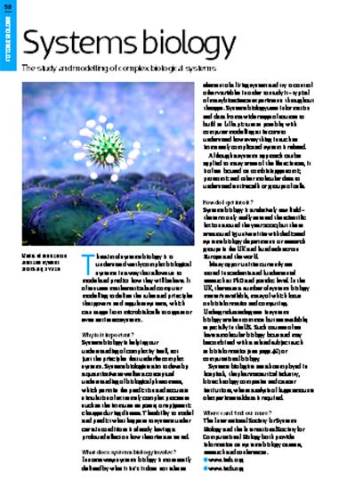
Careers resource
Spotlight on the Life Sciences is a guide to biology careers and includes interviews with biologists:
www.rsb.org.uk/images/Spotlight_on_the_Life_Sciences_-_A_Guide_to_Biology_Careers.pdf
Notes:
Careers resource
About the resource:
Spotlight on the Life Sciences
Guide to biology careers.
Features a collection of articles and interviews from The Biologist magazine, and covers a broad range of bioscience fields.

Slide 13
Career Profile Card/Pitch
Make your own career profile card or create a 30-second pitch for a biology career using the Make a Difference posters/website and Spotlight booklet.
Notes:
Activity 2: Career Profile Card/Pitch
(Delete career profile card/pitch as appropriate)

Slide 14
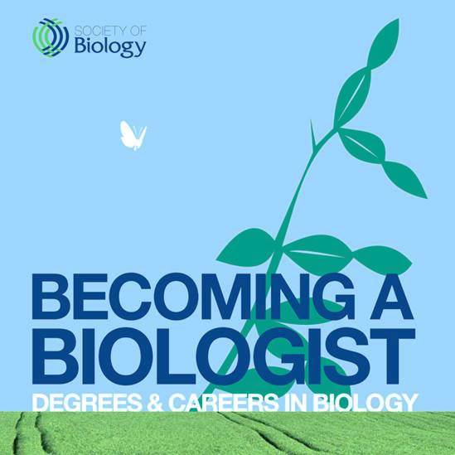
Careers resource
Becoming a Biologist includes information on:
Biology degrees and alternatives
Applying to university
Getting work experience
www.rsb.org.uk/images/Becoming_a_Biologist_Degrees_and_Careers_in_Biology.pdf
Notes:
Careers resource
About the resource:
Becoming a Biologist
Booklet contains information on different types of biological degree and their alternatives, qualifications students will need to study them, skills gained from biological studies, and advice about careers students can do after graduating.

Slide 15
Bingo
Play Biologist Bingo.
Answers can be found by reading the careers booklets.
Notes:
Activity 3: Bingo

Slide 16
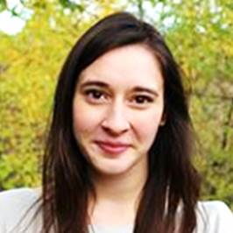
Careers resource
Careers profiles of technicians and research assistants working in a variety of biology-related fields:
Job title:
Research assistant
Organisation:
The Genome Analysis
Centre
Qualifications:
A levels
BSc Biological Sciences
Salary:
£20,000 – £25,000
Meena Anissi
www.rsb.org.uk/careers-and-cpd/careers/employment/technicians-careers-profiles
Notes:
Careers resource
About the resource:
Careers profiles
Profiles of technicians and research assistants working in a variety of fields around the UK.
Information on duties and responsibilities, skills used, career paths, salary, and advice about the sector.
Profiles produced in partnership with BBSRC for Biology Week.

Slide 17
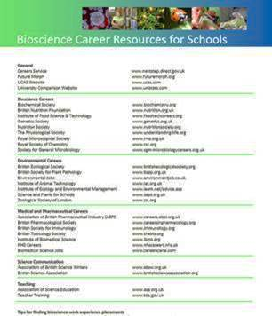
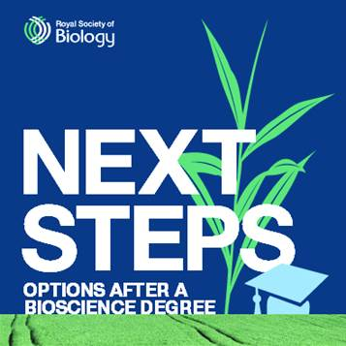
Further support from the Royal Society of Biology
Careers information and guidance resources all available online via:
www.rsb.org.uk/careers
Notes:
Further support for students

Slide 18
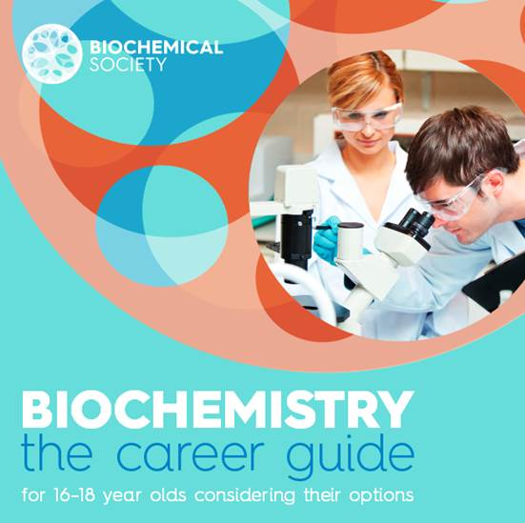
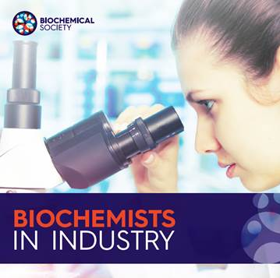
Further support from the Biochemical Society
Careers information and guidance resources are available online via:
www.biochemistry.org/education/schoolsandcolleges.aspx
Notes:
Further support for students

Slide 19
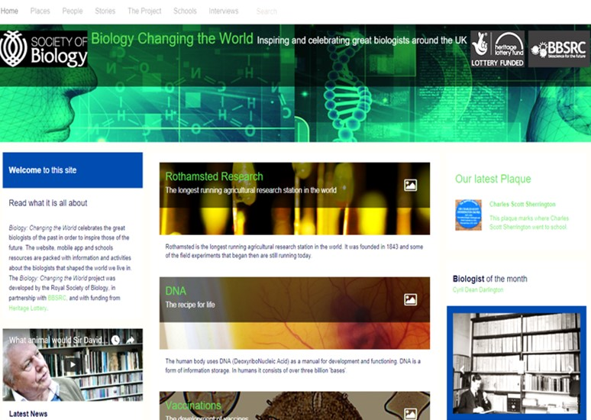
Biology Changing the World
The website celebrates past and present biologists and discoveries that shaped the world:
biologyheritage.rsb.org.uk
Notes:
Biology Changing the World
About the resource:
Celebrates biologists of the past and aims to inspire those of the future.
Website includes information, activities, stories and video interviews.
Project developed by the Royal Society of Biology, in partnership with BBSRC, and with Heritage Lottery funding.

Slide 20
Biology Changing the World
Notes:
Activity 4: Discussion

Slide 21
Biology Changing the World
What inspired Sir David to study biology?
Which biologist from the past would he most like to meet?
What advice does he give to biologists who want to follow a career in science communication?
Which moments in his career does Sir David find memorable?
Notes:
Activity 4: Discussion

